Slide 1

E-PROJECT TRAVEL & TOURS
FACULTY: Sir. Muhammad Haris
Designed By
Miss. Ayesha Naz
Mr. Ayaan Mehfooz
Mr. Muhammad Hammad Shahid
Miss. Maliha Tahir

Slide 2
PROBLEM STATEMENT
Pleasant Tours is into selling various tour products. They have predefined tours with itineraries.
The company advertises by distributing pamphlets, advertising on television, and so on. to hotels, etc.
Due to rapid development in the internet field, the company decided to launch a website where people will get all the information about the various tour products available with them easily. requirement specifications.
The website is to be developed for the Windows Platform using HTML5, JavaScript
and Geolocation. The site should work well in all leading browsers including Chrome,
IE, Firefox etc.

Slide 3
REQUIREMENT SPECIFICATION
3) The information should be categorized according to different types of products if a User wants to see only ‘Beach Tours’ then he clicks on a Link/button/menu etc. and he will see different types of beach tours. Similarly, for ‘Hill Stations’, ‘Forts/Palaces’, and other products
4) When a user selects any product type, a list of products for that product type will be displayed.
5) The itinerary of individual tour products should be displayed on the Web Page along with the title but detailed itinerary should be stored in Individual Word documents which can be downloaded or viewed by the User who wishes to see the same.
The Web site is to be created based on the following requirements.
1) The Home Page should be created by making use of Section graphics and a suitable logo
2) The site should display a menu that will contain the options for a brief introduction about the various products available, the location of the shop, and any other information if required
6) Price Lists for all tours should be available for download.
7) There should be a “Contact Us” page which will have the Address of the Company which is as follows and the mail address which when clicked will invoke the local mail client from where they can send an email.

Slide 4

NAVBAR
The Navbar Contain Following:
2) Booking
1) Home
3) Packages
4) Gallery
5) Services
6) About
7) Contact Us

Slide 5
NAVBAR
The Navbar Contain Following:
1) Home
2) Booking
3) Packages
4) Gallery
5) Services
6) About
7) Contact Us

Slide 6
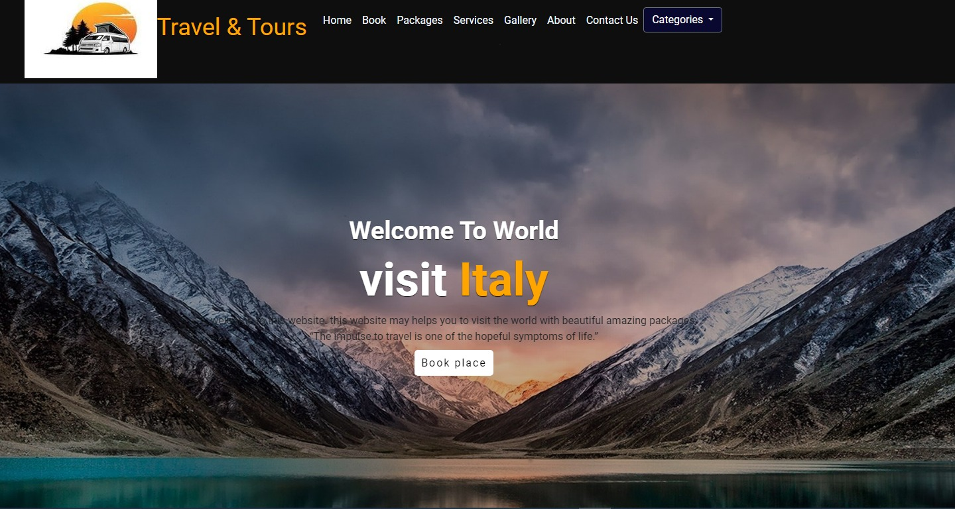
HOME PAGE
home page contain some of our carousel

Slide 7
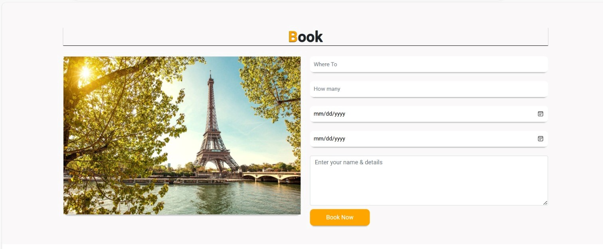
BOOKING
Here you can book your vacations

Slide 8
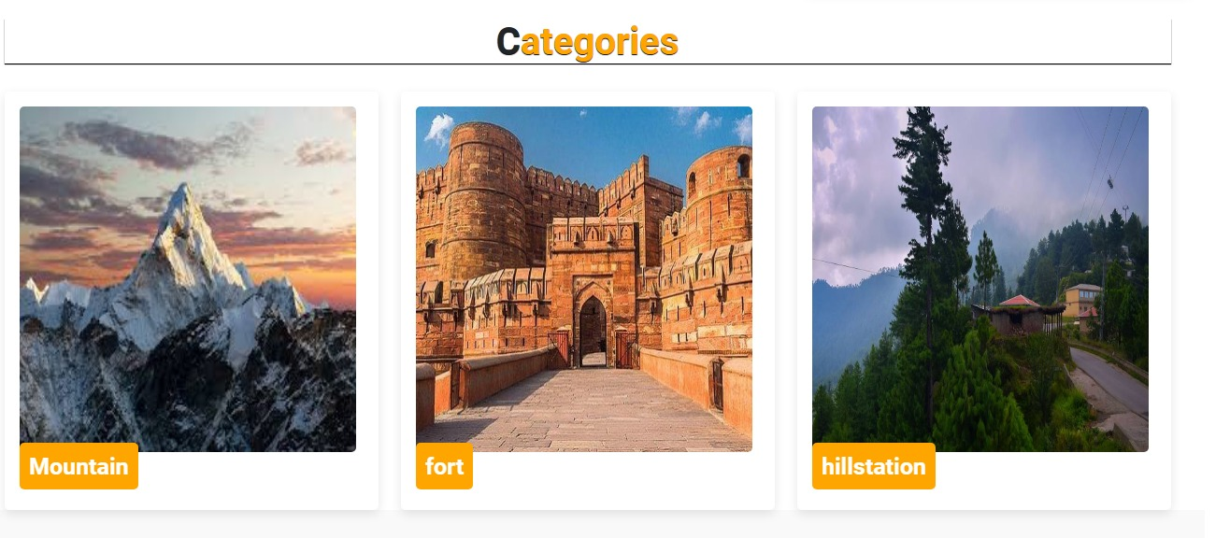
CATEGORIES
Here you can see our best categories

Slide 9
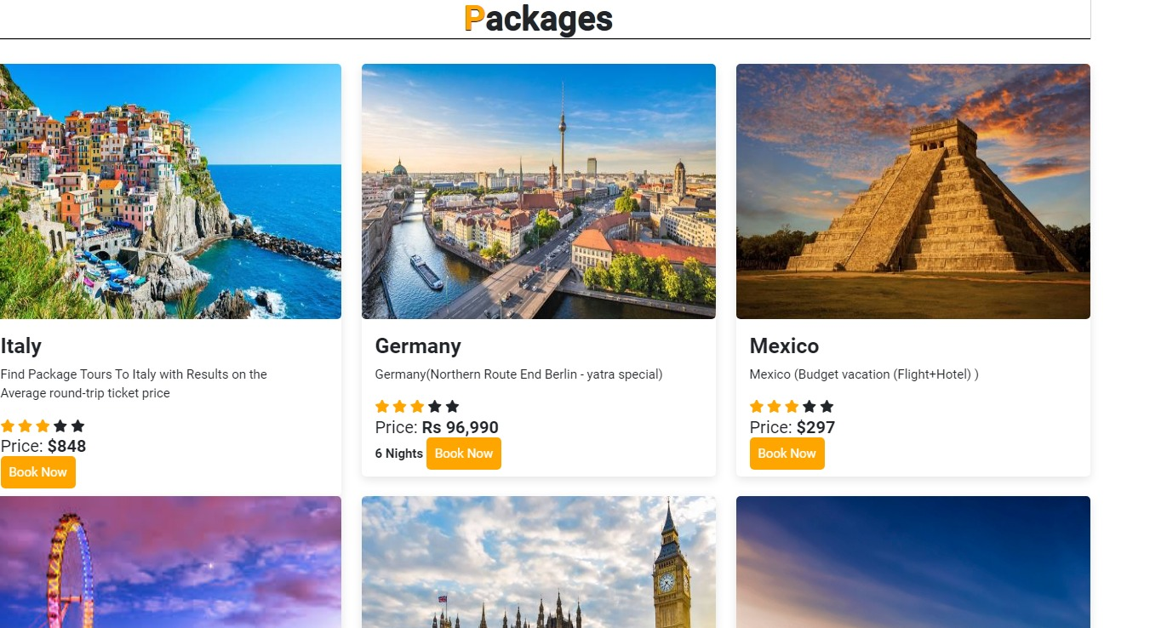
PACKAGES
Here you can see our given best packages from other agencies

Slide 10
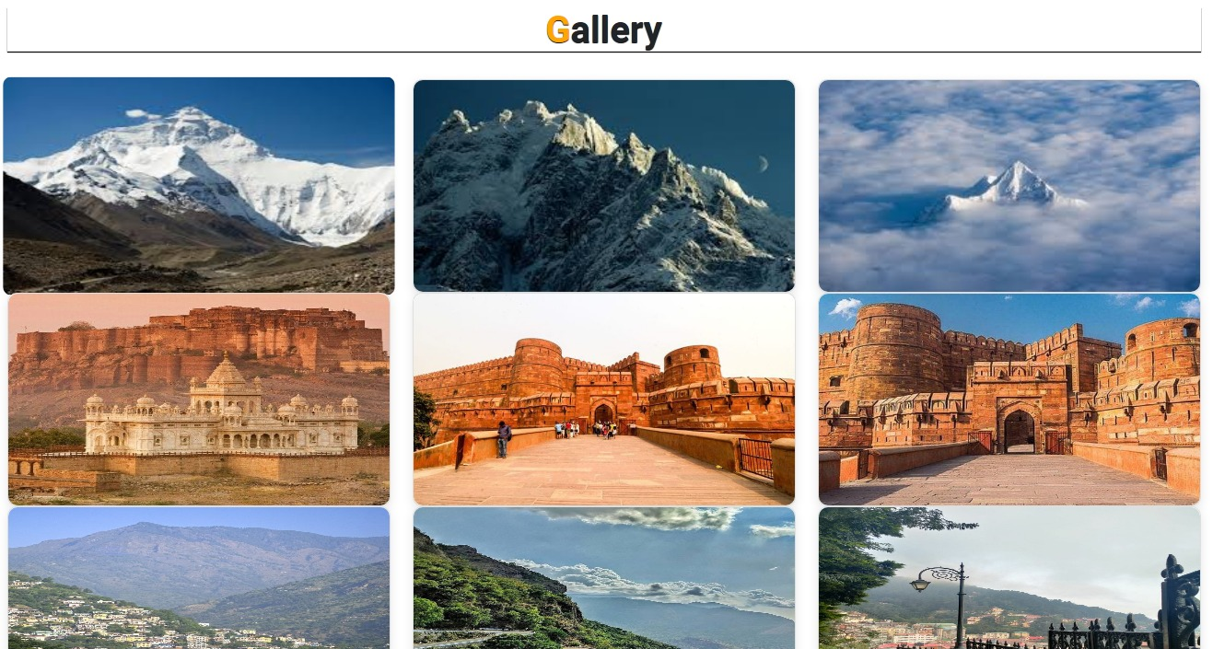
GALLERY

Slide 11
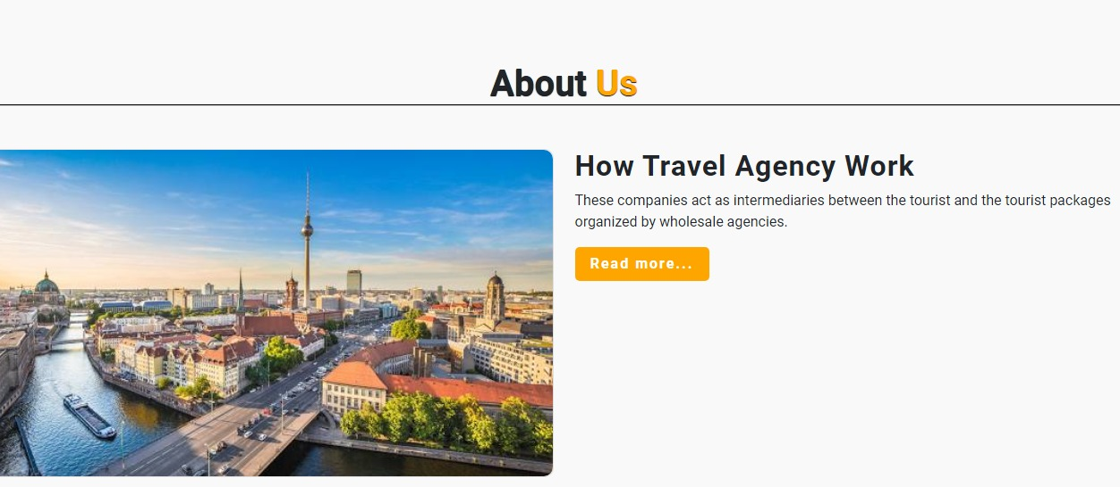
ABOUT US
The About us page contain some introduction about our Websites

Slide 12
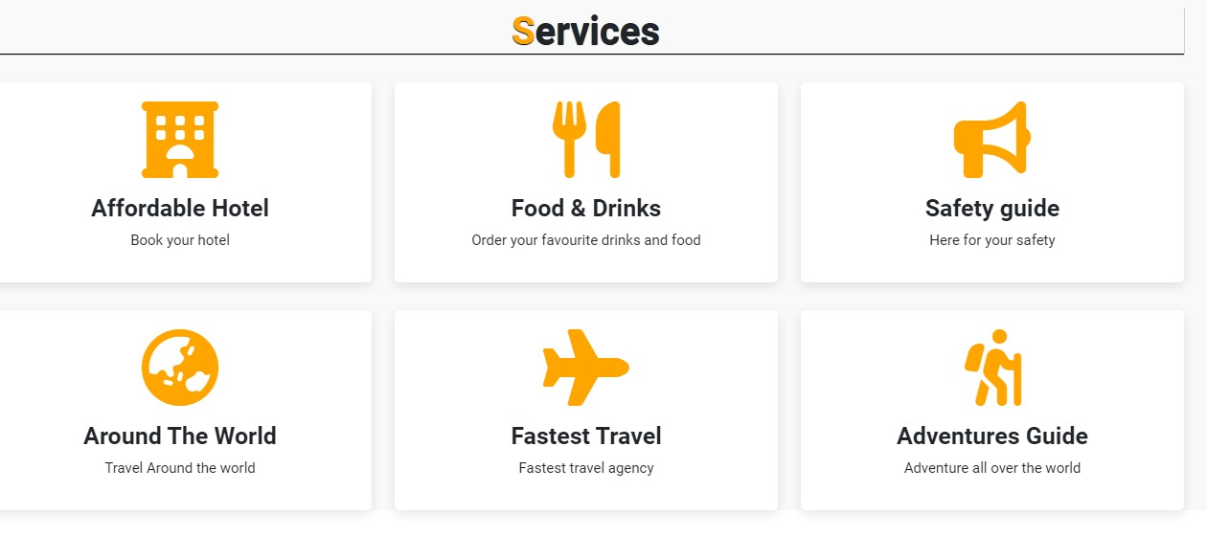
SERVICES
The services page contain all the details of our department and treatments

Slide 13
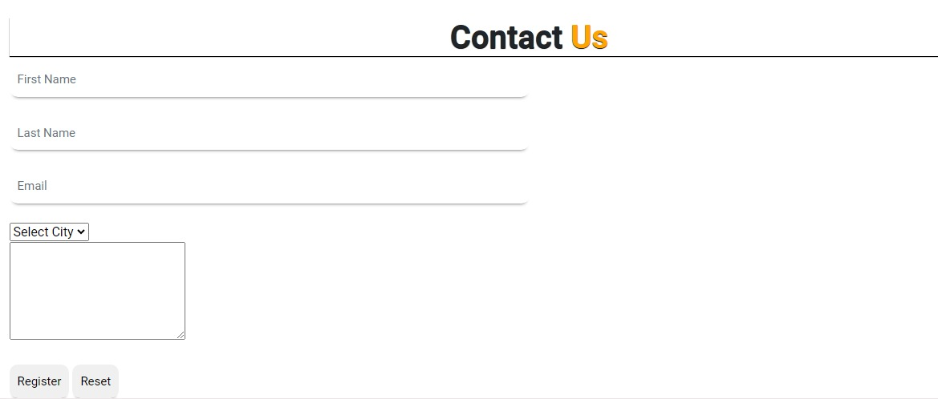
CONTACT US
The following page contain the details of your registration

Slide 14

FOOTER
Footer show you some more details & our social media pages so you can survey our social media accounts

Slide 15
THANK YOU FOR VISITING

